Slide 1
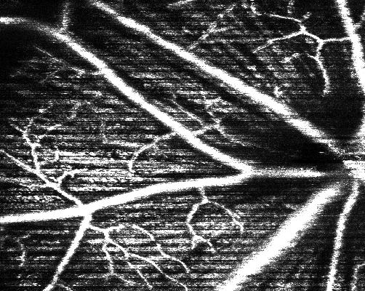
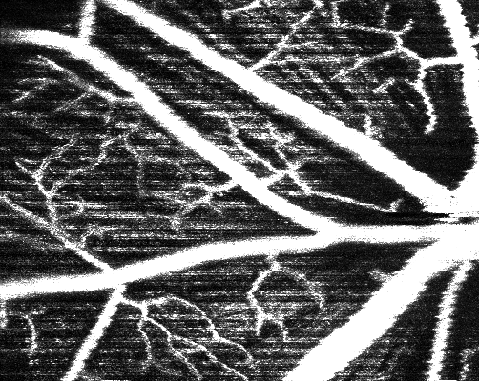
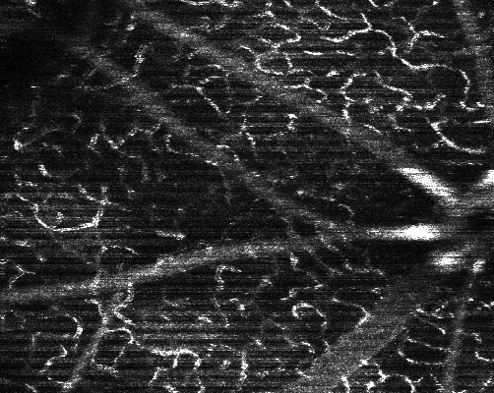
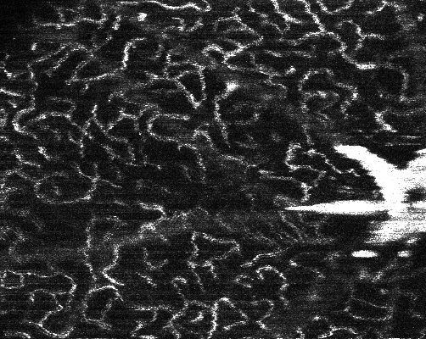
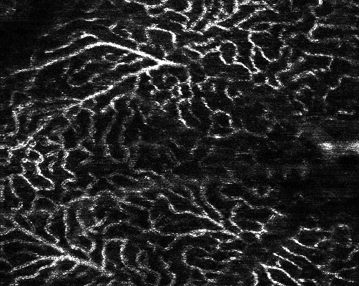
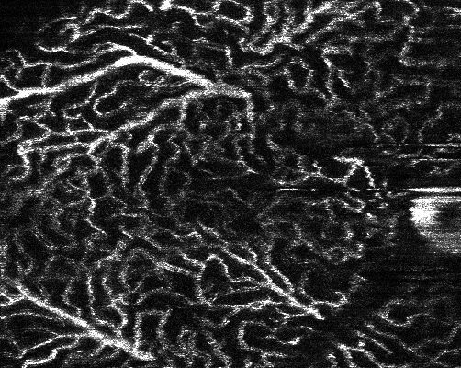
Before Contrast
After Contrast
Pre-Contrast
Post-Contrast
SVP
ICP
DCP
Notes:
From mouse X:\root\processed\2023_06_30_C57BL6_5\2023_06_30_13_08_30\stage_5

Slide 2
B
Maximum Intensity Projection
OCTA
Maximum Intensity Projection
Binarisation
Pre-Contrast
Time
Time
(a)
(d)
(e)
Peak Contrast
(b)
Post-Contrast
Bold
(f)
(c)

Slide 3
Generali’s’ed
(a)
(b)
Generali’s’ed
Bold
Mismatch
Stretched
Bold
Bold
Stretched

Slide 4
Space
Upto 2 Decimal
Mismatch
Bold
(a)
(c)
(e)
Bold Bigger
(b)
(d)
(f)

Slide 5
(a)
(b)
(c)
(d)
(e)

Slide 6
(a)
(b)
(c)
(d)
(e)

Slide 7
(a)
(b)
(c)
(d)

Slide 8
(a)
(b)
(c)
(d)
***
(e)
(f)
***
**
**
***
**
***
***
***
***
**
(g)
***
(h)
***
***
***
***

Slide 10
(a)
(b)
(c)

Slide 11
Flicker Stimulation – Change in Diameter | Vessel 1 |  | Vessel 2 |  | Vessel 3 |  | Vessel 4 |  | Vessel 5
Gaussian Model Diameter (% Change) | 9.2 | p < 0.0005 | 9.6 | p = 0.0019 | 1.5 | p = 0.59 | 28.5 | p < 0.0005 | 4.9 | p = 0.0008
Generalized Gaussian Model Diameter (% Change) | 1.5 | p = 0.28 | 9.9 | p < 0.0005 | -0.6 | p = 0.79 | 28.4 | p < 0.0005 | 3.1 | p = 0.0034
Binarized Angiogram Diameter (% Change) | -12.5 | p < 0.0005 | -10.2 | p < 0.0005 | -4.2 | p = 0.0011 | 1.0 | p = 0.404 | -9.3 | p < 0.0005
Angiogram Intensity (% Change) | -14.1 | p < 0.0005 | -18.2 | p < 0.0005 | -14.3 | p < 0.0005 | -19.9 | p < 0.0005 | -16.3 | p < 0.0005
Flicker Stimulation – Correlation to Intensity | Vessel 1 |  | Vessel 2 |  | Vessel 3 |  | Vessel 4 |  | Vessel 5
Gaussian Model Diameter Correlation | -0.07 | p = 0.48 | 0.23 | p = 0.019 | -0.28 | p = 0.0044 | -0.15 | p = 0.14 | -0.24 | p = 0.018
Generalized Gaussian Model Diameter Correlation | 0.03 | p = 0.79 | 0.07 | p = 0.47 | -0.28 | p = 0.0056 | -0.14 | p = 0.16 | -0.18 | p = 0.081
Binarized Angiogram Diameter Correlation | 0.59 | p < 0.0005 | 0.80 | p < 0.0005 | 0.27 | p = 0.0077 | 0.46 | p < 0.0005 | 0.52 | p < 0.0005
Overall correlation
Gaussian = -0.101
GG = -0.098
BW = 0.523

